Slide 1
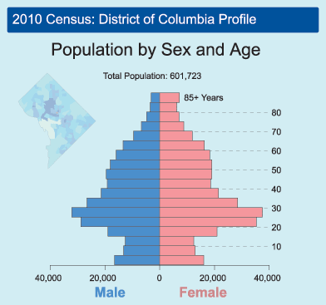
Demographic
Population
Manipulation

Slide 2
Are there too many people?
Wrong question!

Slide 3
Better question!
Why are there so many people?

Slide 4
(Always be suspicious of Yes/No questions!)
Better question!
Why are there so many people?

Slide 5
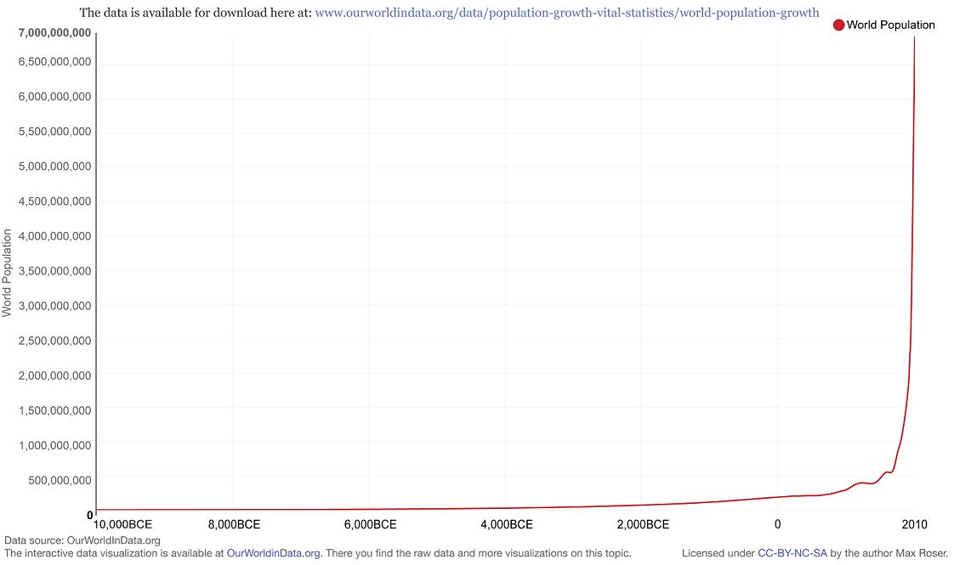

Slide 6
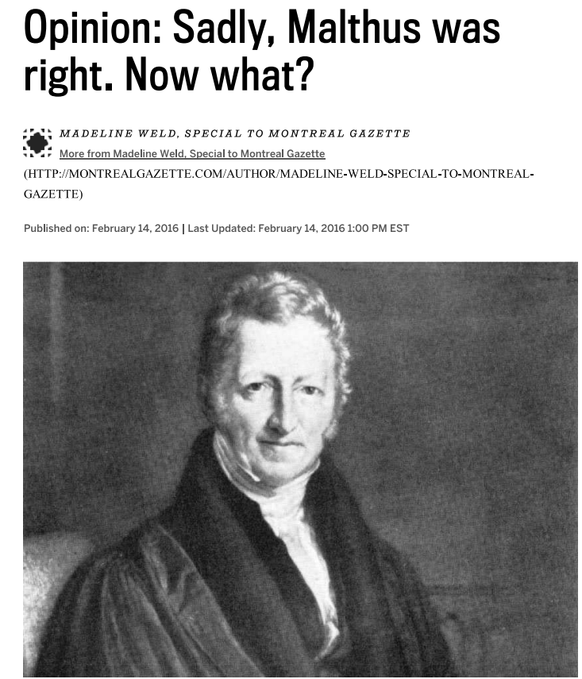
Are there too many people?
Thomas Malthus
“Power of population is indefinitely greater than the power of the earth to produce subsistence."
Yes, population CAN grow faster than food.
He is correct about the thermodynamics of it – more people require more energy/resources.

Slide 7
Are there too many people?
Thomas Malthus
“Power of population is indefinitely greater than the power of the earth to produce subsistence."
Yes, population CAN grow faster than food.
He is correct about the thermodynamics of it – more people require more energy/resources.
Duh!

Slide 8
Are there too many people?
Interestingly, early capitalist economists recognized the impossibility of perpetual growth, and tried to think of how it could be checked.
This is something many mainstream economists don’t even acknowledge today.
Duh!

Slide 9
Are there too many people?
Mainstream economics today subscribes to an ideology of growth. At best they are concerned with how all populations can grow equitably.
But the dogma of growth is hardly ever questioned.
Duh!

Slide 10
Are there too many people?
So, what did Malthus suggest?
Says "misery must fall somewhere" and maintains that the positive checks will necessarily be the lot of the lower classes.
Duh!

Slide 11
Are there too many people?
Malthus explains the misery of the lower classes as the result of a natural law which functions "absolutely independent of all human regulation."
The distress among the lowest classes has, therefore, to be interpreted as "an evil so seated that no human deeply ingenuity can reach it…”
Duh!

Slide 12
Are there too many people?
“Helping the lower classes only increases aggregate human misery.”
Increasing subsistence levels to "a part of society that cannot in general be considered as the most valuable part diminishes the shares that would otherwise belong to more industrious and worthy members.”
Duh!

Slide 13
Are there too many people?
“Helping the lower classes only increases aggregate human misery.”
Increasing subsistence levels to "a part of society that cannot in general be considered as the most valuable part diminishes the shares that would otherwise belong to more industrious and worthy members.”
Wrong!
the asymmetrical accumulation of wealth increases human misery.

Slide 14
Are there too many people?
So, Malthus (and others) wanted to check growth by (more or less) letting the poor suffer and/or die.
They talk about ‘benign neglect’ and doing away with charity.
BUT, this reasoning is wrong, even according to the logic of capitalism.

Slide 15
Are there too many people?
So, Malthus (and others) wanted to check growth by (more or less) letting the poor suffer and/or die.
They talk about ‘benign neglect’ and doing away with charity.
Early economists advocated for a capitalist system because THEY DIDN’T UNDERSTAND WHAT IT WAS!
BUT, this reasoning is wrong, even according to the logic of capitalism.

Slide 16
Are there too many people?
They thought there could be a static economic equilibrium.
They didn’t grasp that the system is based on perpetual directional accumulation.
Early economists advocated for a capitalist system because THEY DIDN’T UNDERSTAND IT.

Slide 17
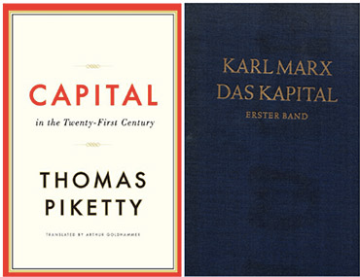
Are there too many people?
The ‘unproductive laboring poor who spend their money on drink and amusement’ are created by and indispensable to capital resource distribution.
We do not have a ‘population problem’ we have an inequality, exploitation, poverty problem!

Slide 18
Are there too many people?
The current resource distribution system is predicated on perpetual growth, this requires the creation of new markets, at some point then, this requires new humans (consumers & laborers).
In order to stem, stop, or reverse overpopulation will require that we no longer measure wealth and value in terms of its future capacities – how much it can grow.
We do not have a ‘population problem’ we have a resource consumption problem!

Slide 19
Labor & Capital
Capital = anything used to generate / accumulate more wealth (in the future).
Continued accumulation requires expansion of the labor force.
If labor supply remains constant increasing demand for labor generated by need to accumulate more will increase wages.
We do not have a ‘population problem’ we have a resource consumption problem!

Slide 20
Labor & Capital
This will mean falling profits, which will mean decreasing rate of accumulation.
How do you overcome this paradox of either increasing wages or decreasing accumulation?
By the production and maintenance of more poor laborers (wages stay down, asymmetrical accumulation remains high).
Perpetual growth demands perpetual poverty.
We do not have a ‘population problem’ we have a resource consumption problem!

Slide 21
Labor & Capital
“Laborers produce the means by which they are made superfluous.”
“A disposable industrial reserve army of labor must constantly be maintained.”
“Creates a mass of human material always ready for exploitation.”
We do not have a ‘population problem’ we have a resource consumption problem!

Slide 22
Labor & Capital
“Poverty is built in to the system of capitalism no matter what the rate of population growth.”
“Poverty of laboring classes is result of capitalist law of accumulation... It’s an endemic condition internal to the capitalist mode of production...”
We do not have a ‘population problem’ we have a resource consumption problem!

Slide 23
Labor & Capital
It sounds paradoxical to mainstream economics, but slowing or stopping the growth of the economy is the best way to reduce poverty.
Indefinite perpetual growth of wealth (mathematically) demands perpetual growth of poor.
Instead of putting checks on population growth, why not check economic growth?????
We do not have a ‘population problem’ we have a resource consumption problem!

Slide 24
Are there too many people?
Demographics are NOT ‘ethically neutral’.
Science is not free of ideology.
Malthus had an ideology & Marx had an ideology.
The scientific method is an ideology.

Slide 25
Are there too many people?
Malthusians believe in environmental determinism.
Marxist believe in historical determinism.
But maybe the world and social relations are not deterministic at all?

Slide 26
What happened here?

Slide 27
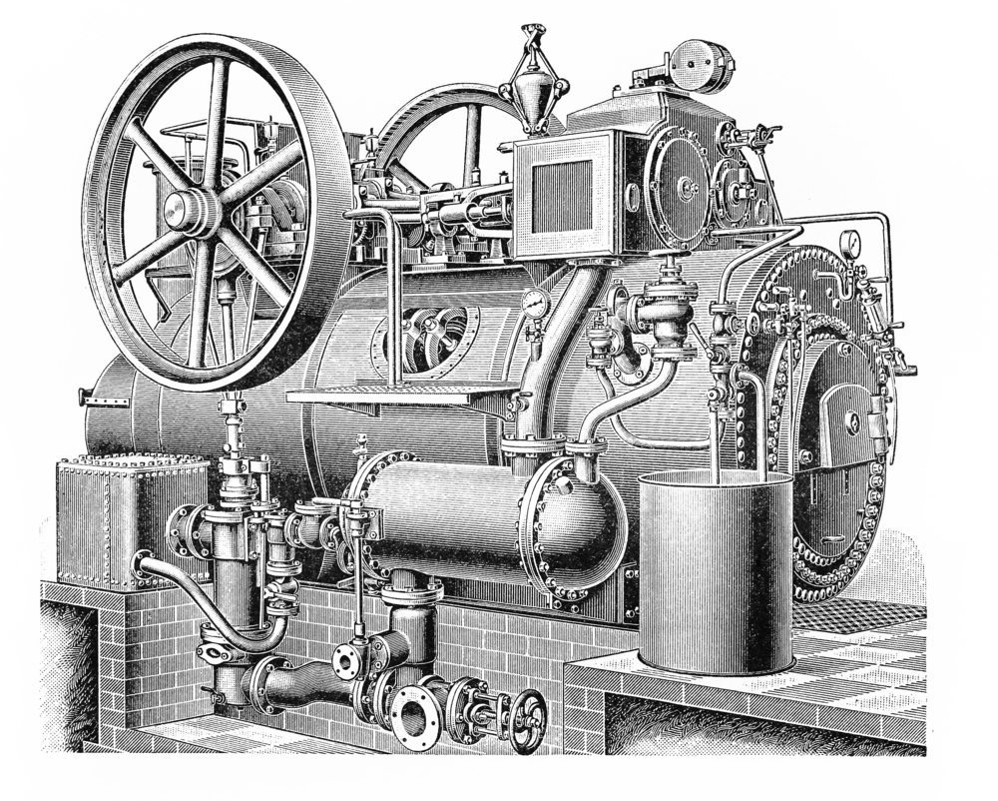
Industrialization...

Slide 28
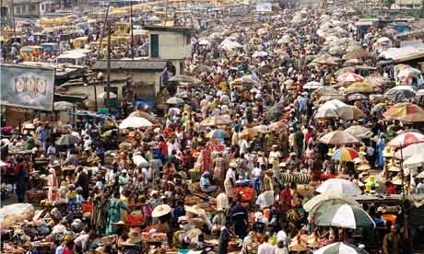
Illusion of Scarcity
When we employ the idea of a ‘population problem’ or a resource availability problem, it creates the specter or threat of scarcity.
Scarcity = the idea that there is a finite amount of resources (and that there won’t be enough for everybody).

Slide 29
Illusion of Scarcity
When we employ the idea of a ‘population problem’ or a resource availability problem, it creates the specter or threat of scarcity.
Scarcity = the idea that there is a finite amount of resources (and that there won’t be enough for everybody).
It’s true that resources are finite,
but it is NOT true that there is
not enough for everyone.
There’s not enough resources for
everyone to have as many as this
guy.

Slide 30
Illusion of Scarcity
When we employ the idea of a ‘population problem’ or a resource availability problem, it creates the specter or threat of scarcity.
Scarcity = the idea that there is a finite amount of resources (and that there won’t be enough for everybody).
Scarcity generates value

Slide 31
Illusion of Scarcity
When we employ the idea of a ‘population problem’ or a resource availability problem, it creates the specter or threat of scarcity.
Scarcity = the idea that there is a finite amount of resources (and that there won’t be enough for everybody).
The scarcer something is the more value it has (generally).
Scarcity generates value

Slide 32
Illusion of Scarcity
When we employ the idea of a ‘population problem’ or a resource availability problem, it creates the specter or threat of scarcity.
Scarcity = the idea that there is a finite amount of resources (and that there won’t be enough for everybody).
The scarcer something is the more value it has (generally).
Scarcity generates value
WHY?

Slide 33
Illusion of Scarcity
This framing of the problem frames base subsistence as a competition: “I’ve got to get mine before someone else does because there’s not enough for everybody.”
This is a tactic for pitting poor working labor against poor working labor, for making U.S. workers see Mexican or Indian or Chinese workers as their “competition.”

Slide 34
Illusion of Scarcity
This framing of the problem pits base subsistence as a competition: “I’ve got to get mine before someone else does because there’s not enough for everybody.”
This is a tactic for pitting poor working labor against poor working labor, for making U.S. workers see Mexican or Indian or Chinese workers as their “competition.”
“Whenever a theory of overpopulation seizes hold in a society dominated by an elite, then the non-elite invariably experience some form of political, economic, and social repression.”

Slide 35
Illusion of Scarcity
If you seriously want to reduce population, you have to ask ‘who is unnecessary?’. Certainly, you’re not, I’m not. It must be ‘The Other’ that is unnecessary... SCARY...
Framing this as an over-population problem is a way to get the population to accept the status quo…
“Whenever a theory of overpopulation seizes hold in a society dominated by an elite, then the non-elite invariably experience some form of political, economic, and social repression.”

Slide 36
Illusion of Scarcity
If you seriously want to reduce population, you have to ask ‘who is unnecessary?’. Certainly, you’re not, I’m not. It must be ‘The Other’ that is unnecessary.
Framing this as an over-population problem is a way to get the population to accept the status quo…
And who is the status quo good for???

Slide 37
Illusion of Scarcity
If you seriously want to reduce population, you have to ask ‘who is unnecessary?’. Certainly, you’re not, I’m not. It must be ‘The Other’ that is unnecessary.
Framing this as an over-population problem is a way to get the population to accept the status quo…
And who is the status quo good for???
Not poor people!
Those in power

