Slide 1
The case of Bitcoin
& The Limits to Growth

Slide 2
What are the
limits to growth?

Slide 3
What are the
limits to growth?
Population increases by a billion every 12 or 13 years!
Population increases 200,000 per day
(350,000 born v. 150,000 die)

Slide 4
Space
What are the
limits to growth?
Money
Energy
Food
Water

Slide 5
What are the
limits to growth?
Money
Energy

Slide 6
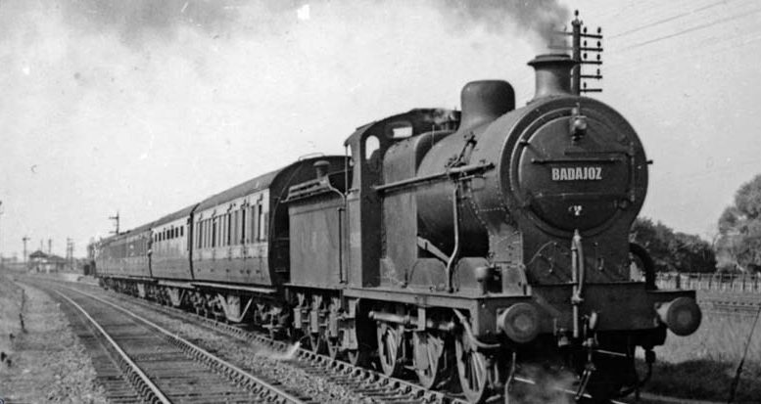
ENERGY
&
MONEY

Slide 7
ROBBER
BARONS
John D. Rockefeller
Industry: Oil
Worth (today): $341 billion

Slide 8
ROBBER
BARONS
Jeff Bezos
Industry: Retail
Worth (today): $110 billion
Bill Gates
Industry: Tech
Worth (today):
$90 billion

Slide 9
Energy = Money
In 1800 water power and steam power are equally efficient.
Water power is cheaper.
Why switch to steam power (coal)?
Because you cannot profit off of water power. You cannot sell the flow.
You can sell coal power as a commodity.

Slide 10
Energy = Money
Efforts to engineer hydraulic energy infrastructure all relied on collective distribution and maintenance of the power supply (socialism).
This is not good for an economy based on the growth of private wealth (capitalism).
Unfortunately coal use has the side effect of altering the composition of the atmosphere.

Slide 11
Energy = Money
The self-sustaining growth of the Industrial economy is combined with the combustion of fossil fuels.
“No stationary state is possible based on fossil energy; when this system has reached its limits, a new contraction must set in. The only escape could be a shift to novel energy carriers. Therefore, the fossil energy regime is a transitional regime and the society built upon it is a transitional society.” -Sieferle

Slide 12
Money = Energy
Money is made by moving things around the planet faster and faster (using energy)
What if we didn’t have to move things around to the planet to make money?
What if we could just turn the consumption of energy directly into money?

Slide 13
hello Bitcoin!

Slide 14
hello Bitcoin!
Cryptocurrency started in 2009.
1 bitcoin is worth $9,000 today. They have been worth as much as $19,000.
What can you do with a bitcoin? The same thing you can do with government backed money?
Not exactly.

Slide 15
hello Bitcoin!
You could sell it to someone who wants to buy bitcoins because they think they will continue to rise in value. So if you sold 10 bitcoins you’d make $90,000.
Can you buy things? Exchange? Trade?
A few stores and online retailers accept bitcoin. But it’s wild fluctuations don’t really make it a good medium of exchange.

Slide 16
hello Bitcoin!
PRO:
Prevents banks from profiting off your money? disempowers banks?
CON:
Allows trade and exchange of illicit goods: drugs, weapons, sex
Subject to wild fluctuations.

Slide 17
hello Bitcoin!
Also:
Allows people to hide their taxable earnings and avoid sales tax.
Allows you to get around Central Bank policies on interest.
Your transactions cannot be tracked like with dollars.
Potentially interest-free way to store money.

Slide 18
hello Bitcoin!
Also:
Allows people to hide their taxable earnings and avoid sales tax.
Good or bad?
Allows you to get around Central Bank policies on interest.
Your transactions cannot be tracked like with dollars.
Potentially interest-free way to store money.

Slide 19
hello Bitcoin!
At the end of the day national currencies are backed up by laws which can be enforced by force. At the end of the day police and military defend the value of the dollar.
Laws are theoretically written by people that you have elected to write them.

Slide 20
hello Bitcoin!
At the end of the day the value of Bitcoin is backed up by trust in the integrity of the coding and algorithm of its creator(s).
This trust in the algorithm is an abandonment of the idea that humans are capable of socially organize on their own, that more trust should be put into algorithms than human interaction?

Slide 21
hello Bitcoin!
At the end of the day the value of Bitcoin is backed up by trust in the integrity of the coding and algorithm of its creator(s).
But most importantly (to me)
This trust in the algorithm is an abandonment of the idea that humans are capable of socially organize on their own, that more trust should be put into algorithms than human interaction.

Slide 22
hello Bitcoin!
Bitcoin requires a shit-ton of energy.
Bitcoin requires as much energy as the nation Denmark.
Bitcoin uses as much energy as the U.S. military.
They say if the velocity at which Bitcoin’s energy consumption has expanded continues, it would require more energy than all the world currently uses by the year 2020.

Slide 23
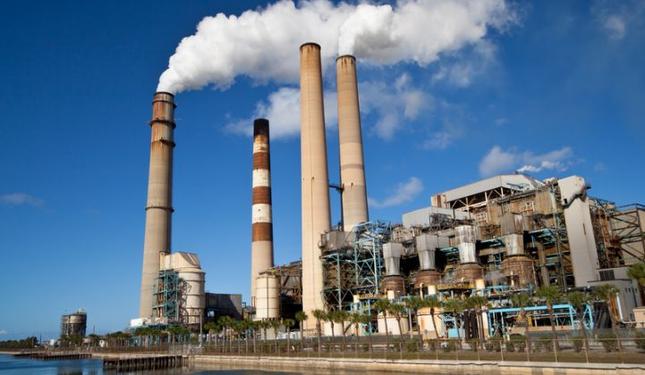
hello Bitcoin!
Bitcoin’s value is directly tied to the consumption of energy.
Requires extremely high computing power to “mine” a bitcoin.
Bitcoin is highly inequitable.
Currently 95% of Bitcoins are owned by 4% of the Bitcoin community.

Slide 24
hello Bitcoin!
Bitcoin’s value is directly tied to the consumption of energy.
Requires extremely high computing power to “mine” a bitcoin.
So how do you get a Bitcoin anyway…?
Bitcoin is highly inequitable.
Currently 95% of Bitcoins are owned by 4% of the Bitcoin community.

Slide 25
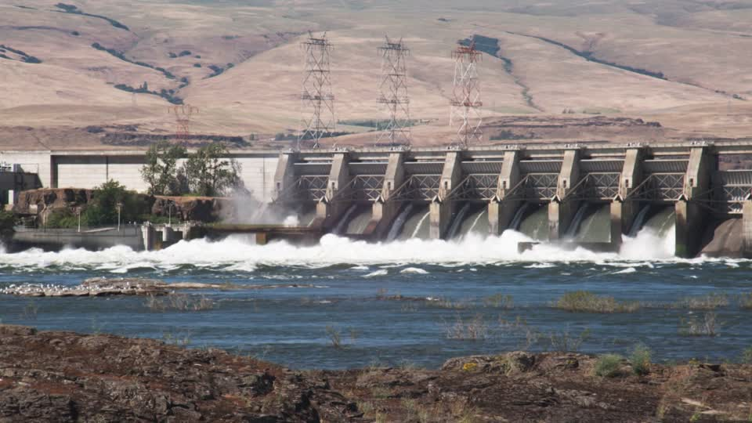
The Columbia River
A case study
The Columbia River in Washington has five hydroelectric power plants.
It generates the cheapest country in the nation.
It even sells its surplus energy to California.
In 2013 Bitcoin miners began moving to the area to set up “mines.”

Slide 26
The Columbia River
A case study
Early Bitcoin miners need hundreds of high speed servers and “heavy-duty cooling systems to keep them from melting down as they churned out trillions of calculations.”
Now they have tens of thousands of servers.
They are quite tangibly just transforming the regions energy into a cryptocurrency.

Slide 27
The Columbia River
A case study
So, to mine a bitcoin, you basically have to have your computer solve a puzzle. The early computers could make 12 billion guesses per second. Today they are a thousand times faster.
Every transaction over Bitcoin is recorded and encrypted.
As more transactions are conducted, the more complex the encryption…

Slide 28
The Columbia River
A case study
So, there is a weird echo chamber effect.The more computers that are mining Bitcoin, the more complicated the puzzles get to solve, which requires more and more computers.
Every transaction over Bitcoin is recorded and encrypted.
When you pay someone in bitcoin, you set in motion a process of escalating, energy- intensive complexity.

Slide 29
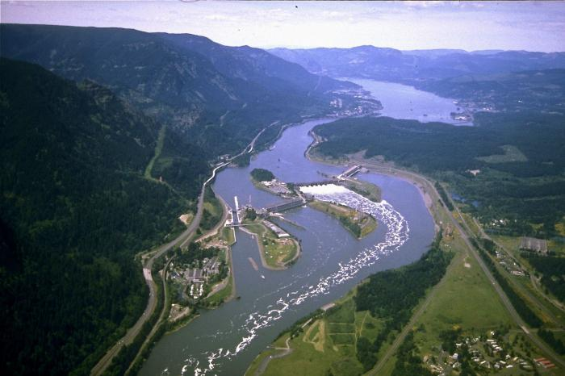
The Columbia River
A case study
Many small fires have been started by overheated electrical infrastructure.
Plus, all this energy consumption is cutting into the area’s business model of selling surplus energy to other cities. Thus, raising the rates of their own energy bills.

Slide 30
The Columbia River
A case study
Understandably this has caused some troubles in the towns of the Columbia River.
Local utilities managers have struggled to meet the demand of foreign investors
Sometimes requests for more energy are denied to miners, which leads to lawsuits.
Overuse of electricity has shorted out the grids.

Slide 31
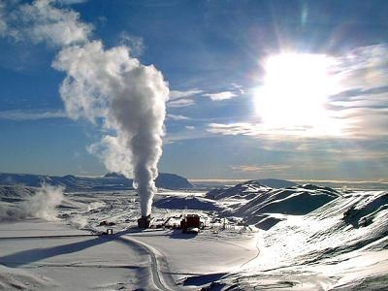
The Columbia River
A case study
(At least it’s hydroelectric energy).
Similar mining schemes are going on in Venezuela (oil) and China (coal), and using cheap fossil fuel supplies.
They’re also doing it in Iceland on clean, renewable geothermal energy.

